Slide 1
Iowa House Prices
By Nobel Gautam

Slide 2
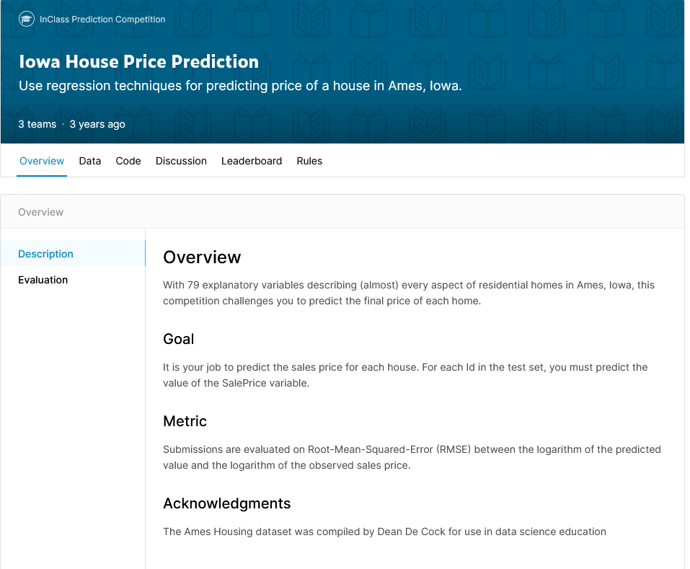
Data
Given features of a house listing, predict the sale price.

Slide 3
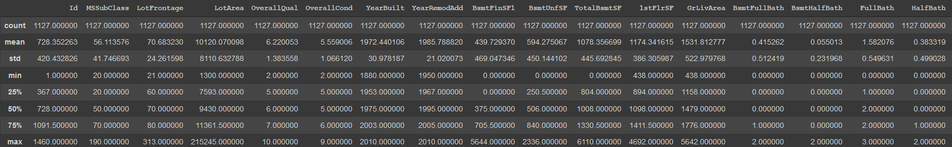
Data
80 columns. However, a lot of them are low-info.
Lots of categorical columns.
For simplicity, only use numerical columns (and transform categorical to numerical where applicable).
Example subsection of data.describe()

Slide 4
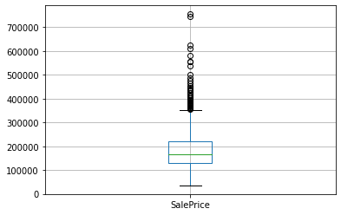
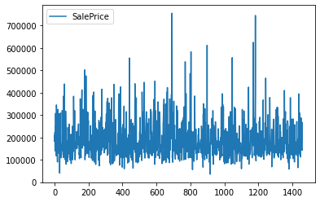
Data
House sale price average ~185k, outliers exceeding 700k

Slide 5
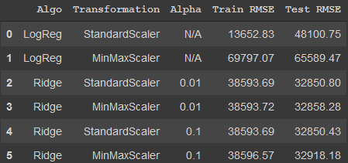
Logistic Regression
Run logistic regression and ridge regression on dataset, testing StandardScaler() and MinMaxScaler() as ways to transform values.
Test ridge regression with alpha 0.01 and 0.1.
Measured in Root Mean Squared Error.

Slide 6
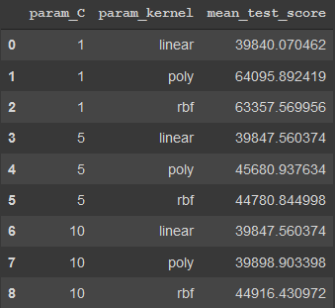
SVM
Use grid search to find optimal parameters.
Tested C=1,5,10 kernel=linear,poly,rbf
Test score measured in RMSE

Slide 7
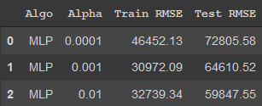
Neural Network
Multi-Layer Perceptron with (6,6) hidden layers, with relu activation.
Tested alphas 0.0001, 0.001, 0.01.
Issues: more complex model overfit drastically, with incredibly low train error but high test error. Settled at (6,6) as a compromise.

Slide 8
Results
Logistic Regression:
StandardScaler and MinMaxScaler performed similarly. StandardScaler performed better for Logistic regression, but performed on par with MinMaxScaler for ridge regression.
Changing alpha did not change error much.
Best result with Ridge, alpha=0.01, StandardScaler.

Slide 9
Results
SVM:
Linear kernel appears to work the best.
Higher C better for poly,rbf. Did not matter for linear.
Best results with C=1 and linear kernel.

Slide 10
Results
Neural Network:
Model overfits training data. Drastically lower error for training data.
Higher complex models had incredible amount of overfitting (train RMSE in the hundreds), but lower complexity models had high error.
Best result appears to be MLP with alpha=0.01.

Slide 11
Conclusions
On an average sale price of 185k and standard deviation of 83k, the best model (logistic regression) had MRSE of 32k. Not too bad.
Trained on 845 rows, 26 columns (down from 80). Did not analyze most columns.
Models would work better if all categorical data was used, unfortunately didn’t have the time.

